Slide 1
C++ Programming:
Problem Solving and Programming
Chapter 8
Standard Functions

Slide 2
Objectives
In this chapter you will:
Learn about standard (predefined) functions and discover how to use them in a program
They are:
  Mathematical functions
  Character functions
  String functions
  Input functions

Slide 3
Standard (Predefined) Functions
They are functions (or modules) whose definitions have been written and are ready to be used in the programs
They are organized as a collection of libraries or header files
The corresponding header file has to be included in the program before the standard function can be used in the program,
e.g. pow(x,y) in <cmath> header file and
isalpha(ch) in <cctype> header file

Slide 4
Mathematical Functions
Mostly defined in <cmath> header file, some in <cstdlib> header file
  abs(x) – returns the absolute value of integer argument.
  fabs(x) – returns the absolute value of floating-point argument.
  pow(x,y) – returns the value of x raised to the power of y, x^{y}.
  sqrt(x) – returns the square root of the argument.
  ceil(x) – returns the next higher integer in double.
  floor(x) – returns the next lower integer in double.
Notes:
AACS1513 Introduction To Programming

Slide 5
Mathematical Functions
  sin(x) – returns the sine of the argument. The argument should be an angle expressed in radians.
  asin(x) – returns the arcsine of the argument in radians.
  fmod(x,y) – returns the remainder of x divided by y in double. Both x and y are also double.
  exp(x) – returns the exponential function of the argument.
  log(x) – returns the natural logarithm of the argument (base-e logarithm).
  log10(x) – returns the base-10 logarithm of the argument.
Notes:
AACS1513 Introduction To Programming

Slide 6
Mathematical Functions - Examples
Function | Data type | Function and example | Library Header
Square root | double | sqrt(16.0) | cmath
Power | double | pow(2.0, 3.0) | cmath
Ceiling | double | ceil(3.2) | cmath
Floor | double | floor(3.2) | cmath
Absolute integer | int | abs(-7) | cstdlib
Absolute double | double | fabs(-7.5) | cmath
Notes:
AACS1513 Introduction To Programming

Slide 7
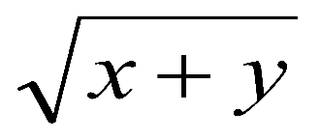
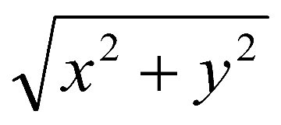
Mathematical Functions - Exercise
What is the output for each of the follows?
abs(-6) 2. fabs(-9.2) 3. fabs(-8)
ceil(2.1) 5. ceil(-2.1) 6. floor(2.5)
7.floor(-2.5) 8. ceil(4.0)
Convert the following mathematical expression to C++ arithmetic expression
a) b) c)
|x – y|
Notes:
AACS1513 Introduction To Programming
1. 6
2. 9.2
3. 8
4. 3
5. -2
6. 2
7. -3
8. 4
a) sqrt(x + y)
b) abs(x-y)
c) sqrt(pow(x,2) + pow(y,2))

Slide 8
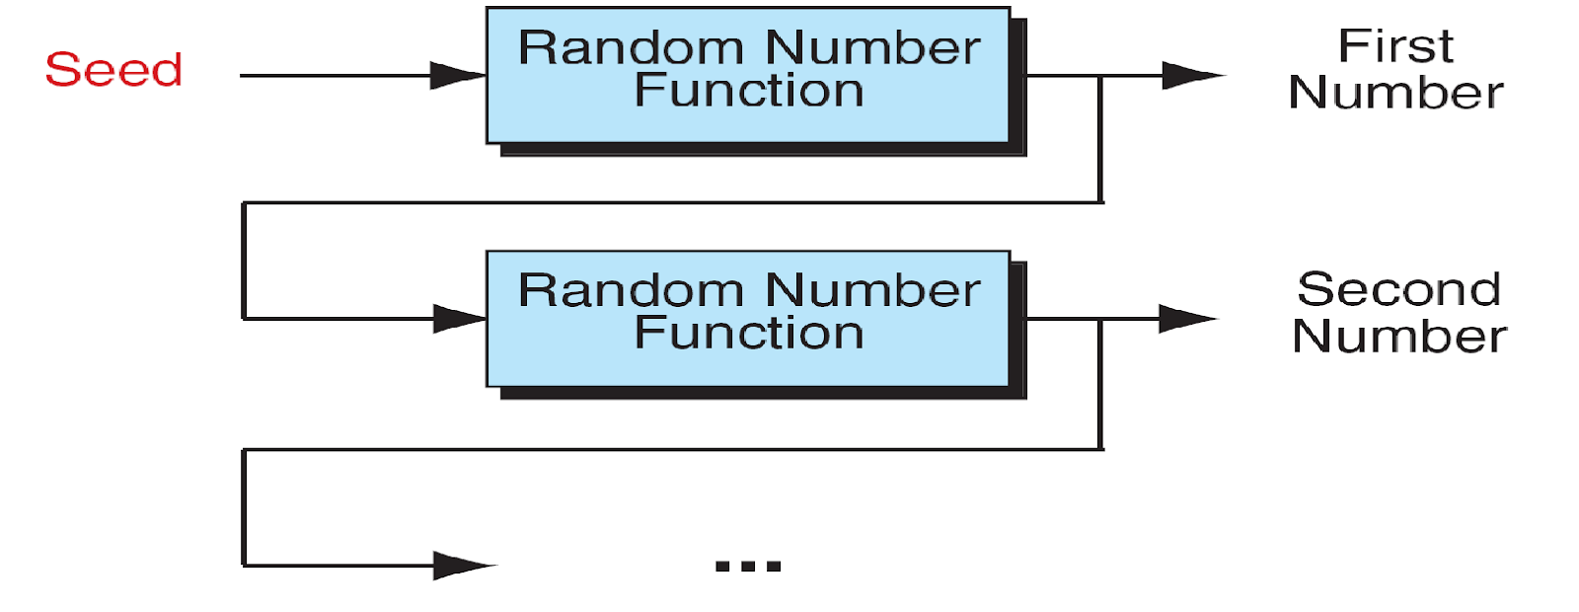
Random Functions
  Defined in <cstdlib> header file
  Use two functions:
    srand()
    rand()
Notes:
AACS1513 Introduction To Programming

Slide 9
Random Functions – srand( )
srand()
  seed random number function
  creates the starting seed for pseudorandom number series (a repeatable series of numbers with random properties)
  Used by random number generator rand( ) to calculate the next number in the series.
  Each seed will produce a different series.
  As each number is generated, it becomes the seed for the next number in the series.
Notes:
AACS1513 Introduction To Programming

Slide 10
Random Functions – srand( )
  To generate a different series in each run, use the time as the seed.
srand(time(NULL));
OR
srand(time(0));
  Returns the current time in seconds.
  time function requires <ctime> header file
  srand( ) must be called/executed only once for each random number series.
  Place srand( ) after variable declarations but before rand function.
Notes:
AACS1513 Introduction To Programming

Slide 11
Random Functions – rand( )
rand()
  Returns a pseudorandom integer between 0 and RAND_MAX (defined in the standard library as the largest number that rand( ) can generate).
  If srand is not called before the first call to rand, the series will based on the seed 1 and the same series of number will always be generated.
To generate a random integral in a range x to y, first scale the number, then if x is greater than 0, shift the number within the range. We scale the number using modulus operator %.
Notes:
AACS1513 Introduction To Programming

Slide 12
Scaling Random Numbers
Use formula:
rand() % ((max + 1) – min) + min
Example:
To produce random numbers in the range 0 to 50 by using rand()%51
Notes:
AACS1513 Introduction To Programming

Slide 13
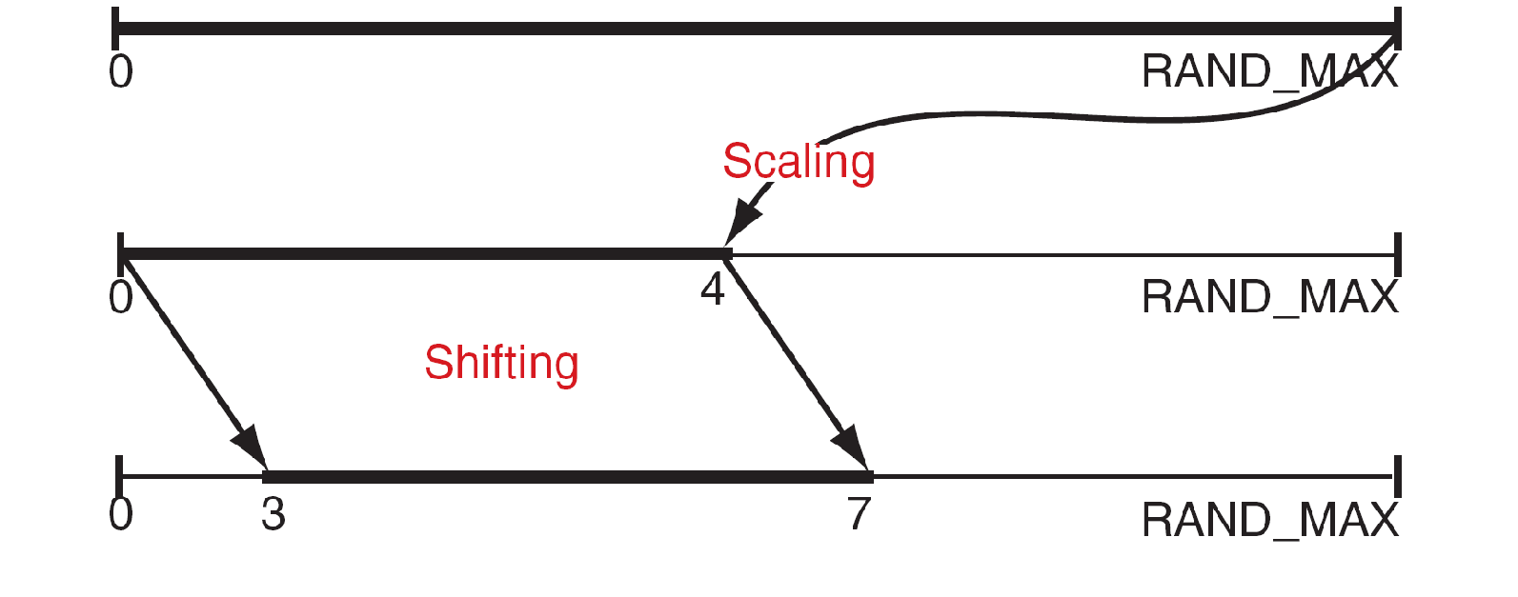
Scaling Random Numbers - Example
To generate random number in the range 3 to 7.
Use the formula where max = 7 and min =3
rand() % ((max+1 – min) + min
→ rand() % ((7+1-3) + 3
→ rand() % 5 + 3
Notes:
AACS1513 Introduction To Programming

Slide 14
Scaling Random Numbers - Example
/* Generate a random series in the range 3 to 7 */
#include <iostream>
#include <cstdlib>
#include <ctime>
using namespace std;
int main ( ) {
int range;
srand (time (NULL)); //Seed function to be called once only
cout << rand() % 5 + 3 << endl;
cout << rand() % 5 + 3 << endl;
cout << rand() % 5 + 3 << endl;
return 0;
}
Notes:
AACS1513 Introduction To Programming

Slide 15
Scaling Random Numbers - Exercise
Define the range of the random numbers generated by the following expressions:
rand() % 11
b) rand() % 11 + 1
c) rand() % 50 – 5
Notes:
AACS1513 Introduction To Programming

Slide 16
Scaling Random Numbers - Exercise
d) Write a program to generate three lucky numbers in the range 100 to 999.
e) Write a program to generate a random number in the range of 1 to 10. Let the user to guess the random number. User is given two chances to guess the number.
Notes:
AACS1513 Introduction To Programming

Slide 17
Character Functions
Defined in <cctype> header file:
isalpha(ch) – returns true (non-zero value) if ch is a letter, otherwise false (zero value)
isdigit(ch) – returns true if ch is a digit, otherwise false
isalnum(ch) – returns true if ch is an lowercase, uppercase or a digit , otherwise false
isspace(ch) – return true if ch is a white space character (‘\n’, ‘ ’, ‘\t’), otherwise false
Notes:
AACS1513 Introduction To Programming

Slide 18
Character Functions
islower(ch) – returns true if ch is a lowercase letter, otherwise false
isupper(ch) – returns true if ch is a uppercase letter, otherwise false
toupper(ch) – converts ch to uppercase.
tolower(ch) – converts ch to lowercase.
Notes:
AACS1513 Introduction To Programming

Slide 19
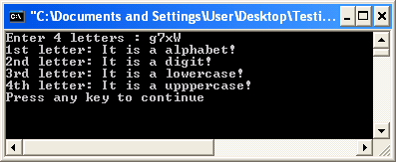
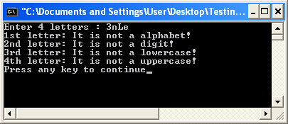
Character Functions - Examples
cout << "Enter 4 letters : ";
cin >> a >> b >> c >> d;
cout<<"1st letter: ";
if (isalpha(a) == 0)
cout<<"It is not a alphabet!\n";
else
cout<<"It is a alphabet!\n";
cout<<"2nd letter: ";
if (isdigit(b) != 0)
cout<<"It is a digit!\n";
else
cout<<"It is not a digit!\n";
cout<<"3rd letter: ";
if (islower(c) = = 0)
cout<<"It is not a lowercase!\n";
else
cout<<"It is a lowercase!\n";
cout<<"4th letter: ";
if (isupper(d) != 0)
cout<<"It is a uppercase!\n";
else
cout<<"It is not a uppercase!\n";
AACS2524 Programming Concepts
Notes:
AACS1513 Introduction To Programming

Slide 20
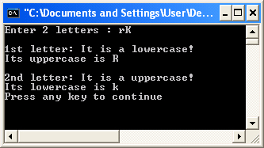
Character Functions - Examples
cout << "Enter 2 letters : ";
cin >> a >> b;
cout<<“\n1st letter: ";
if (islower(a) != 0)
{
cout<<"It is a lowercase!\n";
ch = static_cast<char>(toupper(a));
cout<<“Its uppercase is “<<ch<<endl;
}
cout<<“\n2nd letter: ";
if (isupper(b) != 0)
{
cout<<"It is a uppercase!\n";
ch = static_cast<char>(tolower(b));
cout<<"Its lowercase is “<<ch<<endl;
}
Notes:
AACS1513 Introduction To Programming

Slide 21
String Class Functions
Defined in <string> header file
Declare a string:
#include <string>
void main() {
string name1 = “Muthu Samy”;
string name2 = “”;
string name3 (“Muthu Samy”);
}
Notes:
AACS1513 Introduction To Programming

Slide 22
String Class Functions
Find string length
  E.g. length = str.length();
  Return the length of str including the spaces in between
  str.length() is same as str.size()
Find empty string
  E.g. if(str.empty())
    cout << “String is empty”;
  Return true if string is empty, otherwise false
Notes:
AACS1513 Introduction To Programming

Slide 23
String Class Functions
Compare strings
a = (name1 == name2 );
a = (name1 != name2 );
a = (name1 < name2 );
a = (name1 > name2 );
  Return non-zero if true, zero if false
  E.g. if (username == validName)
        cout << “Valid user”;
Notes:
AACS1513 Introduction To Programming

Slide 24
String Class Functions
Copy string
  E.g. string a, b, name1=“Ahmad”, name2=“May”;
a = name1; // copy name1 to a
b = name2; // copy name2 to b
Concatenate strings
  E.g string a, s1=“abc”, s2=“def”, s3=“ghi”;
a = s1 + s2; // a = “abcdef”
a = s2 + s1; // a = “defabc”
s1 += s3; // s1 = “abcghi” (append)
Notes:
AACS1513 Introduction To Programming

Slide 25
String Class Functions
Print character by character from string
  E.g. string s1 = “abcdef”;
for ( i = 0 ; i < s1.length() ; i++ )
cout << s1.at(i);
Find position of a word or character of a string
  E.g string s1=“Michael Wong Ming Heng”;
a = s1.find(“Wong”); // return 8
b = s1.find (‘g’); // return 11, the 1st out of the other ‘g’ found in s1
Notes:
AACS1513 Introduction To Programming

Slide 26
String Class Functions
Insert string
  E.g. string s1=“Michael Wong Ming Heng”;
s1.insert(8, “Mr. ” );
// s1 = “Michael Mr. Wong Ming Heng”
Replace string
  E.g string s1=“Michael Wong Ming Heng”;
( start , no of char, “replace string”)
s1.replace( 8 , 4 , “Tan”);
// s1 = “Michael Tan Ming Heng”
Notes:
AACS1513 Introduction To Programming

Slide 27
String Class Functions
Append characters to string
  E.g. string s1=“Michael Wong Ming Heng”;
  ( no. of character, ‘character’)
s1.append( 2 , ‘!’ );
// s1 = “Michael Wong Ming Heng!!”
s1.append( “, Dr.”);
// s1 = “Michael Wong Ming Heng, Dr.”
Notes:
AACS1513 Introduction To Programming

Slide 28
String Class Functions
Remove characters from string
  E.g. string s1=“Michael Wong Ming Heng”;
  ( start position, no. of characters)
s1.erase( s1.size( ) - 1, 1 );
// s1 = “Michael Wong Ming Hen”
Notes:
AACS1513 Introduction To Programming

Slide 29
C-String Functions
Conversion functions
Defined in <cstdlib> header file
Does not apply to string class function
  atof(string) // convert numeric string “1.2345” to double
  atoi(string) // convert numeric string “123” to integer
  atol(string) // convert numeric string “123456789” to long integer
Notes:
AACS1513 Introduction To Programming

Slide 30
C-String Functions - Example
#include <iostream>
#include <cstdlib>
using namespace std;
int main() {
char *n=“123.45”; // char n[10]=“123.45;
int m;
m = atof(n) * 100; // convert to double
cout << m; // Answer: 12345
m = atoi(n) * 100;
cout << m; // Answer: 12300
return 0;
}
Notes:
AACS1513 Introduction To Programming

Slide 31
C-String Functions
Manipulation functions
Defined in <cstring> header file
  strcpy(s1,s2) // copy s2 to s1
      strncpy(s1,s2,n) // copy n char from s2 to s1
      strcat(s1,s2) //Append s2 into s1
      strncat(s1,s2,n) //Append n char from s2 to s1
Notes:
AACS1513 Introduction To Programming

Slide 32
C-String Functions - Examples
 | Before |  | After
 | str1 | str2 | str1 | str2
strcpy(str1, str2); | “” | “Nasi Ayam” | “Nasi Ayam” | “Nasi Ayam”
strcpy(str1, str2); | “Mee” | “Goreng” | “Goreng” | “Goreng”
strncpy(str1, str2, 3); | “” | “Tom Yam” | “Tom” | “Tom Yam”
strncpy(str1, str2, 2); | “Nasi” | “Lemak” | “Lesi” | “Lemak”

Slide 33
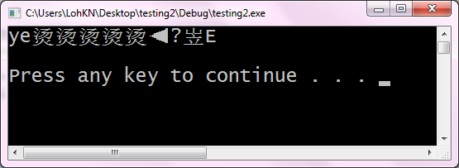
C-String Functions - Examples
char str1[5]="", str2[ ]="yes";
strncpy(str1, str2, 2);
cout << str1;
char str1[5], str2[ ]="yes";
strncpy(str1, str2, 2);
cout<< str1;
str1
y
\0
\0
\0
\0
\0
e
0
1
2
3
4
ye
str1
?
?
?
?
?
y
e
0
1
2
3
4
ye

Slide 34
C-String Functions - Examples
char str1[5]="", str2[ ]="yes";
strcpy(str1, str2);
cout<< str1;
char str1[5], str2[ ]="yes";
strcpy(str1, str2);
cout<< str1;
str1
y
\0
\0
\0
\0
\0
\0
e
s
yes
0
1
2
3
4
str1
?
?
?
?
?
y
e
s
\0
0
1
2
3
4
yes

Slide 35
C-String Functions - Examples
 | Before |  | After
 | str1 | str2 | str1 | str2
strcat(str1, str2); | “Nasi” | “Ayam” | “NasiAyam” | “Ayam”
strcat(str1, str2); | “” | “Goreng” | “Goreng” | “Goreng”
strncat(str1, str2, 3); | “” | “Tom Yam” | “Tom” | “Tom Yam”
strncat(str1, str2, 2); | “Nasi” | “Lemak” | “NasiLe” | “Lemak”

Slide 36
C-String Functions
Comparison functions
Defined in <cstring> header file
  strcmp(s1,s2) // compare s1 to s2
      strncmp(s1,s2,n) // compare up to n char of s1 to s2
Compare | Result | Remark
s1 = s2 | 0 | S1 & S2 match
s1 > s2 | > 0 | S1 is greater than S2
s1 < s2 | < 0 | S1 is less than S2
Notes:
AACS1513 Introduction To Programming

Slide 37
C-String Functions - Examples
 | str1 | str2 | Result
strcmp(str1, str2); | “Nasi” | “Nasi” | 0
strcmp(str1, str2); | “Lemak” | “LeMak” | 1
strcmp(str1, str2); | “LeMak” | “Lemak” | -1
strcmp(str1, str2); | “Cendol” | “Cen” | 1
strncmp(str1, str2, 3); | “Nasi” | “Nanas Lemak” | 1
strncmp(str1, str2, 2); | “ABC12” | “ABC34” | 0
strncmp(str1, str2, 4); | “ABC12” | “ABC34” | -1
Notes:
strcmp(“Cendol”, Cen”);
D =100
\o=0

Slide 38
Example
C-String Functions - Example
char pw[ ]=“abc”, str[4];
cout << “Enter your password: ”;
cin >> str;
if (strcmp(pw, str) == 0)
cout << “Matched\n”;
else
cout << “Invalid password\n”;

Slide 39
Example
C-String Functions
Length function
Defined in <cstring> header file
  strlen(s1) // determine the length of string s1
Example
      char name[ ] = “Yusof Bin Abdullah”
      cout << strlen(name); // Output is 18

Slide 40
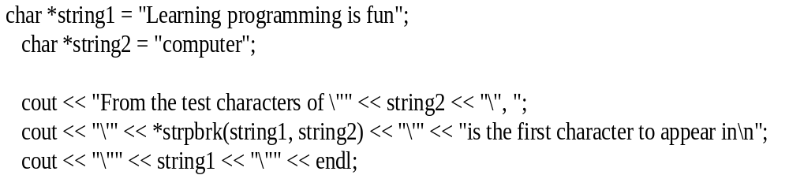
Example
C-String Functions
Locate characters in string function
Defined in <cstring> header file
  strpbrk(string1, string 2)
Example
  From the test characters of “computer”, ‘o’ is the first character to appear in “Learning programming is fun”

Slide 41
Example
Input Functions
cin and get functions (Revision)
  get – used to read character data, including whitespaces.
  Example: char ch1, ch2;
int num;
  Input: A 25
  If using cin in this statement:
cin >> ch1 >> ch2 >> num;
  Result: ch1 = ‘A’ , blank is skipped by the >>
    ch2 = ‘2’
    num = 5

Slide 42
Example
Input Functions
  If using these statements:
cin.get(ch1);
cin.get(ch2);
cin >> num;
Input: A 25
Result: ch1 = ‘A’
    ch2 = ‘ ’ → the blank is not skipped
    num = 25

Slide 43
Example
Input Functions
cin and the ignore function
  ignore – discard a portion of the input.
  Example:
cin.ignore (100, ‘\n’);
    The statement ignores the next 100 characters or until it encounters the character specified (in this case is the newline)

Slide 44
Example
Input Functions
  Example:
  Assume we have variable declaration:
char ch1, ch2;
  Input: Hello there. My name is Mickey.
  With these statements:
cin >> ch1;
cin.ignore (100, ‘.’);
cin >> ch2;
  Result: ch1 = ‘H’
    ch2 = ‘M’ , the blank is skipped by the >>

